Slide 1
Data Base Management System
Prof. Ashwin Verma
NIRMA University

Slide 2
Chapter 1: Introduction
Data/information/knowledge
DBMS
Purpose of Database Systems
View of Data
Data Models
Data Definition Language
Data Manipulation Language
Transaction Management
Storage Management
Database Administrator
Database Users
Overall System Structure

Slide 3
A few years ago, the UK Government Tax office lost some CDs containing 25 million people’s records.
The media used the terms “data” and “information” interchangeably.
For example, one of the frequent mistakes was that they lost “data.” However, you can’t physically lose data. You can’t physically pick up data, move it about, etc.
Data vs Information vs Knowledge
KNOWLEDGE: Knowledge is what we know
Think of this as the map of the World we build inside our brains. Like a physical map, it helps us know where things are – but it contains more than that.
It is from this “map” that we base our decisions, not the real world itself. Our brains constantly update this map from the signals coming through our eyes, ears, nose, mouth and skin.
You can’t currently store knowledge in anything other than a brain.

Slide 4
DATA: Data is/are the facts of the World.
For example, take yourself. You may be 5ft tall, have brown hair and blue eyes. All of this is “data”. You have brown hair whether this is written down somewhere or not.
INFORMATION: Information allows us to expand our knowledge beyond the range of our senses.
Here is a simple analogy for you.
If I take a picture of you, the photograph is information. But what you look like is data.(i.e. boy or girl)
So, in the case of the lost tax records, the CDs were information. The information was lost, but the data wasn’t. Mrs Jones still lives at 14 Whitewater road, and she was still born on 15th August 1971.
Data: Facts, a description of the World
Information: Captured Data
Knowledge: Our personal map/model of the World

Slide 5

Big Data ???
Big Data is also data but with a huge size. Big Data is a term used to describe a collection of data that is huge in size and yet growing exponentially with time.
In short such data is so large and complex that none of the traditional data management tools are able to store it or process it efficiently.
Examples Of Big Data
The New York Stock Exchange generates about one terabyte of new trade data per day.

Slide 6


Social Media
The statistic shows that 500+terabytes of new data get ingested into the databases of social media site Facebook, every day. This data is mainly generated in terms of photo and video uploads, message exchanges, putting comments etc.
A single Jet engine can generate 10+terabytes of data in 30 minutes of flight time. With many thousand flights per day, generation of data reaches up to many Petabytes.

Slide 7
Database Management System (DBMS)
Collection of interrelated data
Set of programs to access the data
DBMS contains information about a particular enterprise
DBMS provides an environment that is both convenient and efficient to use.
Database Applications:
  Banking: all transactions
  Airlines: reservations, schedules
  Universities: registration, grades
  Sales: customers, products, purchases
  Manufacturing: production, inventory, orders, supply chain
  Human resources: employee records, salaries, tax deductions
Databases touch all aspects of our lives

Slide 8
Purpose of Database System
In the early days, database applications were built on top of file systems
Drawbacks of using file systems to store data:
  Data redundancy and inconsistency
    Multiple file formats, duplication of information in different files(dob->age or age->Phoneno)
  Difficulty in accessing data
    Need to write a new program to carry out each new task
  Data isolation — multiple files and formats(changes made by one user is visible to other?)
  Integrity problems
    Integrity constraints (e.g. account balance > 0) become part of program code(or age>18)
    Hard to add new constraints or change existing ones

Slide 9
Purpose of Database Systems (Cont.)
Drawbacks of using file systems (cont.)
  Atomicity of updates
    Failures may leave database in an inconsistent state with partial updates carried out(changing some file content and power off)
    E.g. transfer of funds from one account to another should either complete or not happen at all
  Concurrent access by multiple users
    Concurrent accessed needed for performance
    Uncontrolled concurrent accesses can lead to inconsistencies
      E.g. two people reading a balance and updating it at the same time
  Security problems
Database systems offer solutions to all the above problems

Slide 10
Characteristics of DBMS
It uses a digital repository established on a server to store and manage the information.
It can provide a clear and logical view of the process that manipulates data.
DBMS contains automatic backup and recovery procedures.
It contains ACID properties which maintain data in a healthy state in case of failure.
It can reduce the complex relationship between data.
It is used to support manipulation and processing of data.
It is used to provide security of data.
It can view the database from different viewpoints according to the requirements of the user.

Slide 11
Advantages of DBMS
Controls database redundancy: It can control data redundancy because it stores all the data in one single database file and that recorded data is placed in the database.
Data sharing: In DBMS, the authorized users of an organization can share the data among multiple users.
Easily Maintenance: It can be easily maintainable due to the centralized nature of the database system.
Reduce time: It reduces development time and maintenance need.
Backup: It provides backup and recovery subsystems which create automatic backup of data from hardware and software failures and restores the data if required.
multiple user interface: It provides different types of user interfaces like graphical user interfaces, application program interfaces
Disadvantages of DBMS
Cost of Hardware and Software: It requires a high speed of data processor and large memory size to run DBMS software.
Size: It occupies a large space of disks and large memory to run them efficiently.
Complexity: Database system creates additional complexity and requirements.(training)
Higher impact of failure: Failure is highly impacted the database because in most of the organization, all the data stored in a single database and if the database is damaged due to electric failure or database corruption then the data may be lost forever.

Slide 12
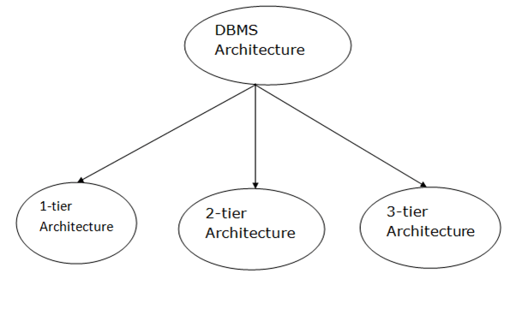
DBMS Architecture
The DBMS design depends upon its architecture. The basic client/server architecture is used to deal with a large number of PCs, web servers, database servers and other components that are connected with networks.
The client/server architecture consists of many PCs and a workstation which are connected via the network.
DBMS architecture depends upon how users are connected to the database to get their request done.

Slide 13
1-Tier Architecture
In this architecture, the database is directly available to the user. It means the user can directly sit on the DBMS and uses it.
Any changes done here will directly be done on the database itself. It doesn't provide a handy tool for end users.
The 1-Tier architecture is used for development of the local application, where programmers can directly communicate with the database for the quick response.(same system)
2-Tier Architecture
The 2-Tier architecture is same as basic client-server. In the two-tier architecture, applications on the client end can directly communicate with the database at the server side. For this interaction, API's like: ODBC, JDBC are used.
An application interface which is called ODBC (Open Database Connectivity) an API which allows the client-side program to call the DBMS.
Today most of the DBMS offers ODBC drivers for their DBMS.
2 tier architecture provides added security to the DBMS as it is not exposed to the end user directly.

Slide 14
3-Tier Architecture
The 3-Tier architecture contains another layer between the client and server. In this architecture, client can't directly communicate with the server.
The application on the client-end interacts with an application server which further communicates with the database system.
End user has no idea about the existence of the database beyond the application server. The database also has no idea about any other user beyond the application.(username password)
The 3-Tier architecture is used in case of large web application. (facebook, youtube,etc.)
**Application server will decide what to do with this request where to forward.

Slide 15

Application Architectures
Two-tier architecture: E.g. client programs using ODBC/JDBC to
communicate with a database
Three-tier architecture: E.g. web-based applications, and
applications built using “middleware”

Slide 16
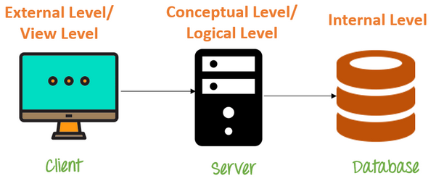
Levels of Abstraction
Database systems comprise of complex data structures. Thus, to make the system efficient for retrieval of data and reduce the complexity of the users, developers use the method of Data Abstraction.
There are mainly three levels of data abstraction:
Physical level: Actual PHYSICAL storage structure and access paths.
Logical Level: Structure and constraints for the entire database
External or View level: Describes various user views

Slide 17
Levels of Abstraction
Physical level: describes the physical storage structure of the database and describes how a record (e.g., customer) is stored.(how much byte a record is required and how much time it will take to access it)
Logical level: describes the Database structure of the whole databasede and data stored in database, and the relationships among the data.
  It hides information about the physical storage structures and focuses on describing data types, entities, relationships, etc.
External level: application programs hide details of data types. Views can also hide information (e.g., salary) for security purposes.
  An external schema describes the part of the database which specific user is interested in.
  It hides the unrelated details of the database from the user. There may be "n" number of external views for each database.

Slide 18

View of Data
An architecture for a database system

Slide 19
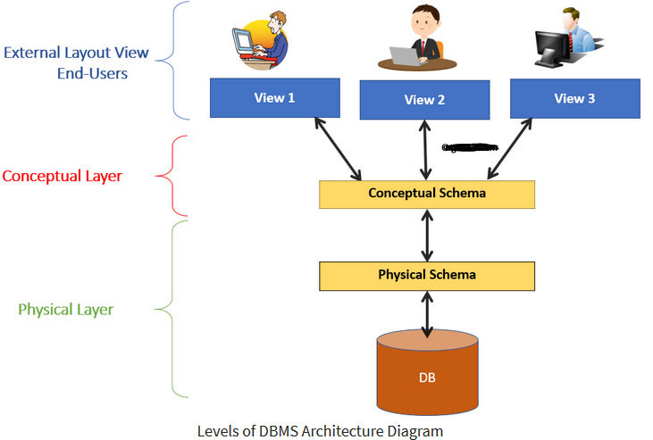

Slide 20
Instances and Schemas
Schema – the logical structure of the database
  e.g., the database consists of information about a set of customers and accounts and the relationship between them)
  A database schema is the skeleton structure of the database. It represents the logical view of the entire database.
  A schema contains schema objects like table, foreign key, primary key, views, columns, data types, stored procedure, etc.
  A database schema is designed by the database designers to help programmers whose software will interact with the database. The process of database creation is called data modeling.
Instance – the actual content of the database at a particular point in time
  Analogous to the value of a variable(a row)

Slide 21
Data Independence
Data Independence is defined as a property of DBMS that helps you to change the Database schema at one level of a database system without requiring to change the schema at the next higher level. Data independence helps you to keep data separated from all programs that make use of it.
Physical Data Independence – the ability to modify the physical schema without changing the logical schema i.e ability to modify the physical schema without causing application programs to be rewritten. Modifications at the physical level are occasionally necessary to improve performance.
  It means we change the physical storage/level without affecting the conceptual or external view of the data. The new changes are absorbed by mapping techniques.
  Storing a same file from pendrive to HDD or SDD with different storage structure

Slide 22
Data Independence
Logical data independence: The ability to modify the logical schema without causing application program to be rewritten.
  Modifications at the logical level are necessary whenever the logical structure of the database is altered (for example, when money-market accounts are added to banking system).
  Logical Data independence means if we add some new columns or remove some columns from table then the user view and programs should not change.
  For example: consider two users A & B. Both are selecting the fields "EmployeeNumber" and "EmployeeName". If user B adds a new column (e.g. salary) to his table, it will not affect the external view for user A, though the internal schema of the database has been changed for both users A & B.

Slide 23
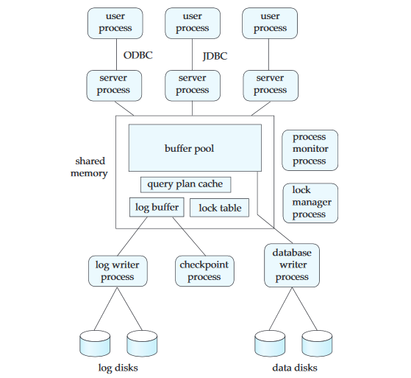

System Architecture(memory-process)
Process monitor process: This process monitors other processes, and if any
of them fails, it takes recovery actions for the process, such as aborting any
transaction being executed by the failed process, and then restarting the
Process.
Server processes: These are processes that receive user queries (transactions),
execute them, and send the results back.
Database writer process: There are one or more processes that output modified
buffer blocks back to disk on a continuous basis.
Log writer process: This process outputs log records from the log record
buffer to stable storage.

Slide 24
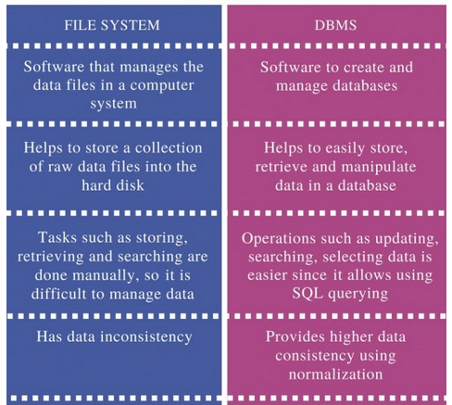
File System vs DBMS

Slide 25
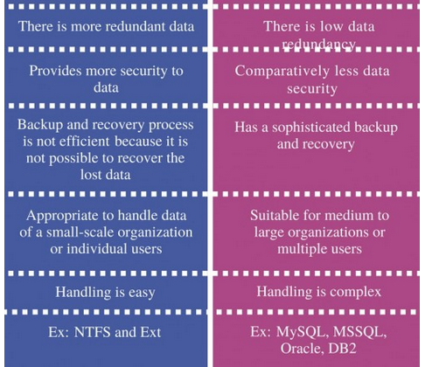
File System vs DBMS

Slide 26
Data Models
A Database model defines the logical design and structure of a database.
Also defines how data will be stored, accessed and updated in a database management system.
Some data base models are:
  Hierarchical Model
  Network Model
  Entity-relationship Model
  Relational Mode
Other models:
  object-oriented model
  semi-structured data models

Slide 27
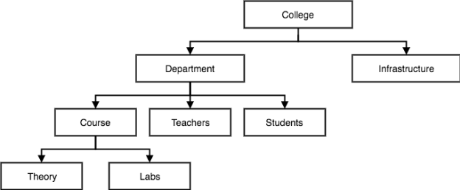
1. Hierarchical Model
This database model organises data into a tree-like-structure, with a single root, to which all the other data is linked.
The hierarchy starts from the Root data, and expands like a tree, adding child nodes to the parent nodes.
In hierarchical model, data is organised into tree-like structure with one one-to-many relationship between two different types of data, for example, one department can have many courses, many professors and of-course many students.

Slide 28
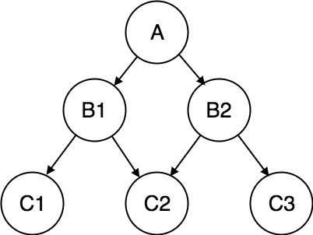
2. Network Model
This is an extension of the Hierarchical model. In this model data is organised more like a graph, and are allowed to have more than one parent node.
In this database model data is more related as more relationships are established in this database model. Also, as the data is more related, hence accessing the data is also easier and fast. This database model was used to map many-to-many data relationships.

Slide 29
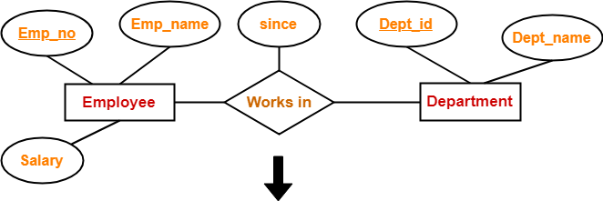
3. ER Model
In this database model, relationships are created by dividing object of interest into entity and its characteristics into attributes.
E-R Models are defined to represent the relationships into pictorial form to make it easier for different stakeholders to understand.
ER Model is based on −
  Entities and their attributes.
  Relationships among entities.

Slide 30
4. Relational Model
The relational model represents the database as a collection of relations.
A relation is nothing but a table of values. Every row in the table represents a collection of related data values.
These rows in the table denote a real-world entity or relationship.
The table name and column names are helpful to interpret the meaning of values in each row.
In the relational model, data are stored as tables. However, the physical storage of the data is independent of the way the data are logically organized.
Some popular relational DBMS are:-
  Oracle
  DB2
  SQL Server and MS access

Slide 31
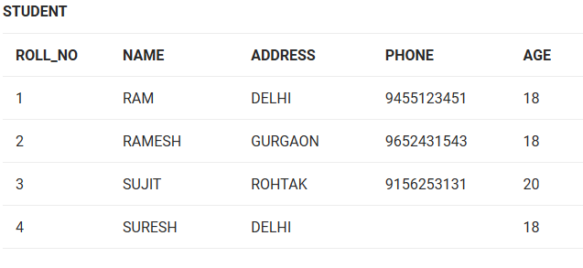
Consider a relation STUDENT with attributes ROLL_NO, NAME, ADDRESS, PHONE and AGE shown in Table 1.
Attribute: Attributes are the properties that define a relation. e.g.; ROLL_NO, NAME
Relation Schema: A relation schema represents name of the relation with its attributes. e.g.; STUDENT (ROLL_NO, NAME, ADDRESS, PHONE and AGE) is relation schema for STUDENT. If a schema has more than 1 relation, it is called Relational Schema.

Slide 32
Tuple: Each row in the relation is known as tuple. The above relation contains 4 tuples, one of which is shown as:
Relation Instance: The set of tuples of a relation at a particular instance of time is called as relation instance. Table 1 shows the relation instance of STUDENT at a particular time. It can change whenever there is insertion, deletion or updation in the database.
Degree: The number of attributes in the relation is known as degree of the relation. The STUDENT relation defined above has degree 5.
Cardinality: The number of tuples in a relation is known as cardinality. The STUDENT relation defined above has cardinality 4.
Column: Column represents the set of values for a particular attribute. The column ROLL_NO is extracted from relation STUDENT.
NULL Values: The value which is not known or unavailable is called NULL value. It is represented by blank space. e.g.; PHONE of STUDENT having ROLL_NO 4 is NULL.
1 | RAM | DELHI | 9455123451 | 18

Slide 33
Constraints in Relational Model
While designing Relational Model, we define some conditions which must hold for data present in database are called Constraints.
These constraints are checked before performing any operation (insertion, deletion and updation) in database. If there is a violation in any of constrains, operation will fail.
Domain Constraints: These are attribute level constraints. An attribute can only take values which lie inside the domain range. e.g,; If a constrains AGE>0 is applied on STUDENT relation, inserting negative value of AGE will result in failure.
Key Integrity: Every relation in the database should have atleast one set of attributes which defines a tuple uniquely. Those set of attributes is called key. e.g.; ROLL_NO in STUDENT is a key. No two students can have same roll number. So a key has two properties:
  It should be unique for all tuples.
  It can’t have NULL values.

Slide 34
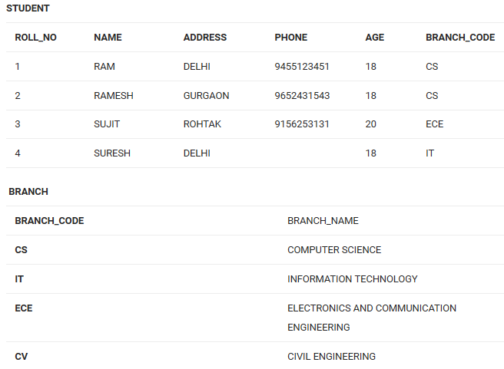
Referential Integrity: When one attribute of a relation can only take values from other attribute of same relation or any other relation, it is called referential integrity. Let us suppose we have 2 relations
BRANCH_CODE of STUDENT can only take the values which are present in BRANCH_CODE of BRANCH relation(table) which is called referential integrity constraint.

Slide 35
Relational Model
Attributes
Example of tabular data in the relational model
Customer-id
customer-
name
customer-
street
customer-
city
account-
number
192-83-7465
019-28-3746
192-83-7465
321-12-3123
019-28-3746
Johnson
Smith
Johnson
Jones
Smith
Alma
North
Alma
Main
North
Palo Alto
Rye
Palo Alto
Harrison
Rye
A-101
A-215
A-201
A-217
A-201

Slide 36

A Sample Relational Database

Slide 37
SQL
SQL stands for Structured Query language, pronounced as "S-Q-L" or sometimes as "See-Quel".
SQL is the standard language for dealing with Relational Databases.
SQL can be used to insert, search, update and delete database records.
SQL can do lots of other operations including optimizing and maintenance of databases. Relational databases like MySQL Database, Oracle, Ms SQL server, Sybase, etc uses SQL.
How to use sql syntaxes?
SQL Example
SELECT * FROM Members WHERE Age > 30
SQL syntaxes used in these databases are almost similar, except the fact that some are using few different syntaxes and even proprietary SQL syntaxes.

Slide 38
SQL Commands
The standard SQL commands to interact with relational databases are CREATE, SELECT, INSERT, UPDATE, DELETE and DROP. These commands can be classified into the following groups based on their nature −
DDL - Data Definition Language
1 CREATE: Creates a new table, a view of a table, or other object in the database.
2 ALTER : Modifies an existing database object, such as a table.
3 DROP :Deletes an entire table, a view of a table or other objects in the database.
DML - Data Manipulation Language
1 SELECT :Retrieves certain records from one or more tables.
2 INSERT :Creates a record.
3 UPDATE :Modifies records.
4 DELETE :Deletes records.
DCL - Data Control Language
1 GRANT :Gives a privilege to user.
2 REVOKE :Takes back privileges granted from user.

Slide 39
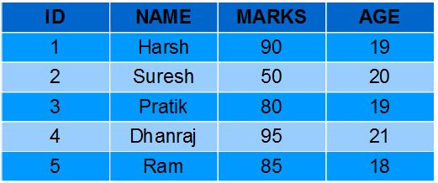
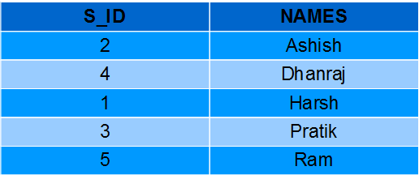
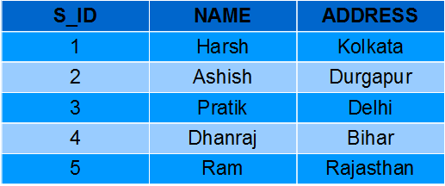
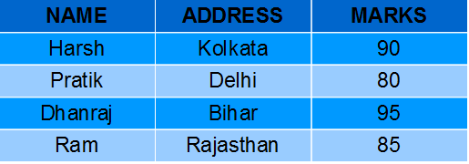
SQL Views
Views in SQL are kind of virtual tables.
A view also has rows and columns as they are in a real table in the database.
We can create a view by selecting fields from one or more tables present in the database.
A View can either have all the rows of a table or specific rows based on certain condition.

Slide 40
Database Users
Users are differentiated by the way they expect to interact with the system
Application programmers – interact with system through DML calls, These DML queries are written in the application programs like C, C++, JAVA, Pascal etc.
Sophisticated users – They are database developers, who write SQL queries to select/insert/delete/update data. They do not use any application or programs to request the database. They directly interact with the database by means of query language like SQL.Specialized users – write specialized database applications that do not fit into the traditional data processing framework
Naïve users – these are the users who use the existing application to interact with the database. For example, online library system, ticket booking systems, ATMs
Stand-alone Users - These users will have stand –alone database for their personal use. These kinds of database will have readymade database packages which will have menus and graphical interfaces.

Slide 41
Database Administrator
Coordinates all the activities of the database system; the database administrator has a good understanding of the enterprise’s information resources and needs.
Database administrator's duties include:
  Installing and upgrading the DBMS Servers.{new projects}
  Design and implementation{create original database, decide proper memory management, file organizations, error handling, log maintenance etc for the database}
  Performance tuning{lots of tables, data, constraints and indices, there will be variations in the performance from time to time. Also, because of some designing issues or data growth, the database will not work as expected}
  Migrate database servers{It is the responsibility of DBA to make sure that migration happens without any failure, and there is no data loss}
  Backup and Recovery{periodically backup, ensuring disk space and upgrading it}
  Security{various database users and roles, and giving them different levels of access rights}
  Documentation{documenting all his activities, if he quits or any new DBA comes in, he should be able to understand the database without any effort}

Slide 42

Overall System Structure

